Slide 1
Introduction to Data Structure
18ESC108A Elements of Computer Science and Engineering
B. Tech. 2018
Ami Rai
Roopa G
Chaitra S
Department of Computer Science and Engineering
Faculty of Engineering and Technology
Ramaiah University of Applied Sciences

Slide 2
Objectives
At the end of this lecture, students will be able to
Explain the idea of a data structure
Use the operations of a singly linked list data structure
Use the operations of a doubly linked list data structure

Slide 3
Contents
Data structure
Linked List

Slide 4
Derived Data Type
Derived Data Type
Heterogeneous
(Tuples)
Homogeneous
(Lists)

Slide 5

Effect of Data Organisation
In a telephone directory
Find the phone number of any person by name of “Anil”
Find the owner’s name for phone number 23333333

Slide 6
Data Structures
Data Structures
Linked
(Linked Lists, Trees)
Sequential Structures (Lists, Queues, Stacks)

Slide 7
Data Structures
A Data Structure is
A collection of elements of a type
Along with an set of operations defined on it
Base of the programming tools
Choice of data structure provides
The data structure should be satisfactory to represent the relationship between data elements
The data structure should be easy so that the programmer can easily process the data, as per requirement

Slide 8
Abstract Data Types (ADTs)
Abstract Data Types (ADTs)
The Data Structure defined is independent of its implementation
This abstracted definition of a Data Structure and its Operations constitute the ADT
Provides a unified interface independent of the implementation details
May store redundant information to aid efficient operations to be performed on it

Slide 9
Classification of Data Structures

Slide 10
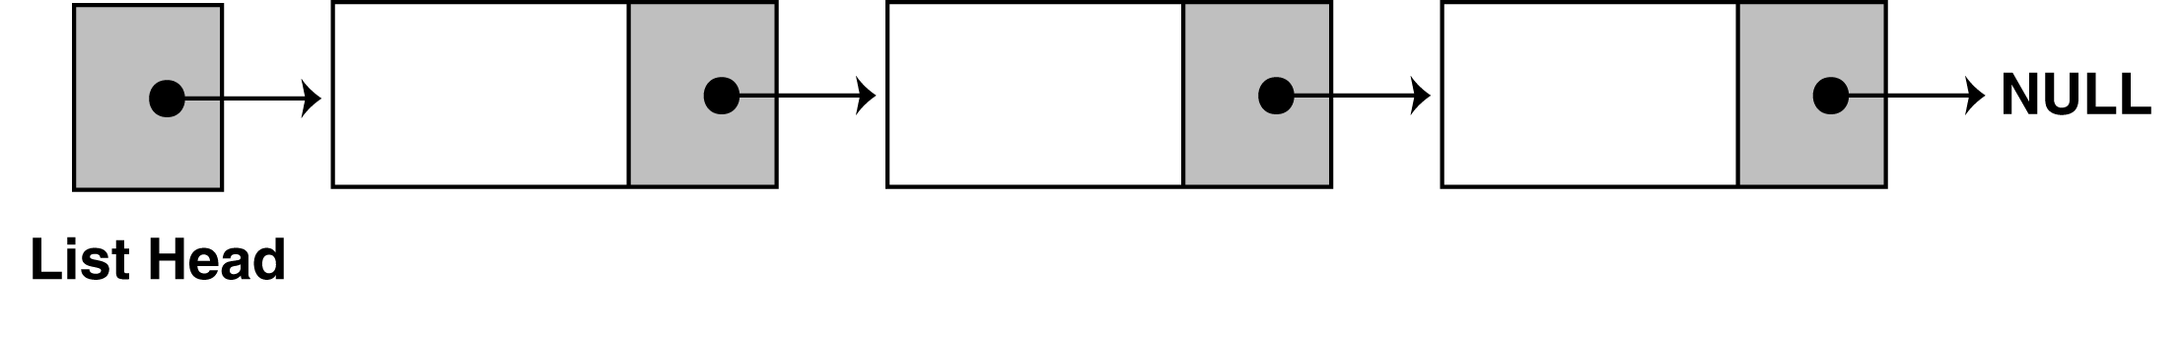
Linked List
A linked list can grow or shrink in size as the program runs
Does not require the shifting of items during insertions and deletions
A linked list is called "linked" because each node in the series has a pointer that points to the next node in the list

Slide 11
Linked List
A linked list is a series of connected nodes
Each node contains at least
A piece of data (any type)
Pointer to the next node in the list
Head: pointer to the first node
The last node points to NULL to mark the end of the list
node
A
data
pointer

Slide 12
A Linked List of Integers

Slide 13
Example of Linked Lists
A waiting line of customers: John, Mary, Dan, Sue (from the head to the tail of the line)
A linked list of strings can represent this line:
John
Mary
Dan
Sue
tail_ptr
head_ptr

Slide 14
What does the memory look like?
Linked list nodes are normally not stored contiguously in memory
Logically, however, the nodes of a linked list appear to be contiguous
a1
a2
a3
a4
Memory
Content
Memory
Address
a1 800
a2 712
a3 992
a4 0
1000
800
712
992

Slide 15
Singly Linked list
Linked list is created by using the node class
class Node:
def __init__(self, dataval=None):
self.dataval = dataval
self.nextval = None

Slide 16
Inserting a Node
Three cases can arise for inserting a node:
Insertion at the beginning of the list
Insertion at the end of the list
Insertion in the middle of the list

Slide 17
Inserting at the Beginning of a Linked List
To insert a node at the beginning involves pointing the next pointer of the new data node to the current head of the linked list
The current head of the linked list becomes the second data element and the new node becomes the head of the linked list
NewNode.nextval = self.headval
self.headval = NewNode

Slide 18
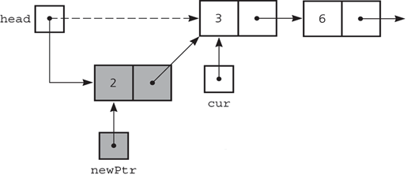
Insertion at the Beginning

Slide 19
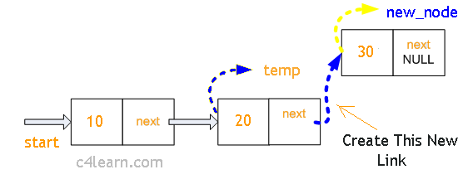
Insertion at the End of the List
This involves pointing the next pointer of the current last node of the linked list to the new data node

Slide 20
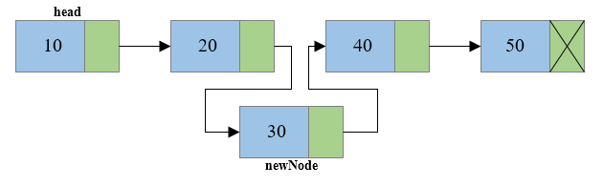
Insertion in the middle of the list
Change the pointer of a specific node to point to the new node

Slide 21
Deleting a Node from list
Existing node can be removed by using the key for that node
delete B;
a
b
c
A->next = C;

Slide 22
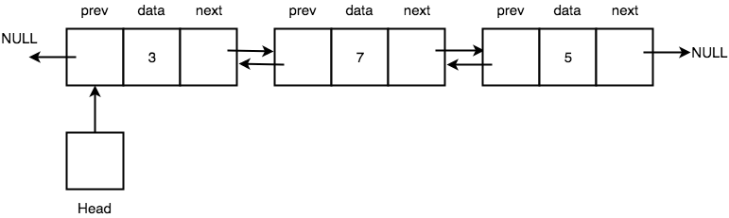
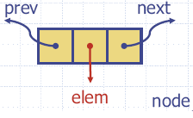
Doubly Linked List
Doubly Linked List provides a better implementation of the Link ADT (than Singly Linked List)

Slide 23
Advantages over Singly Linked List
We can traverse a Doubly Linked List in both forward and backward directions
When we have to delete any node in a Singly Linked List, we have to define an additional pointer to keep track of the previous node, which is not required in case of Doubly Linked List

Slide 24
Summary
Linked lists optimise memory usage when compared with lists for dynamically changing data
There are various categories of linked lists such as singly linked list and doubly linked list

